Slide 1
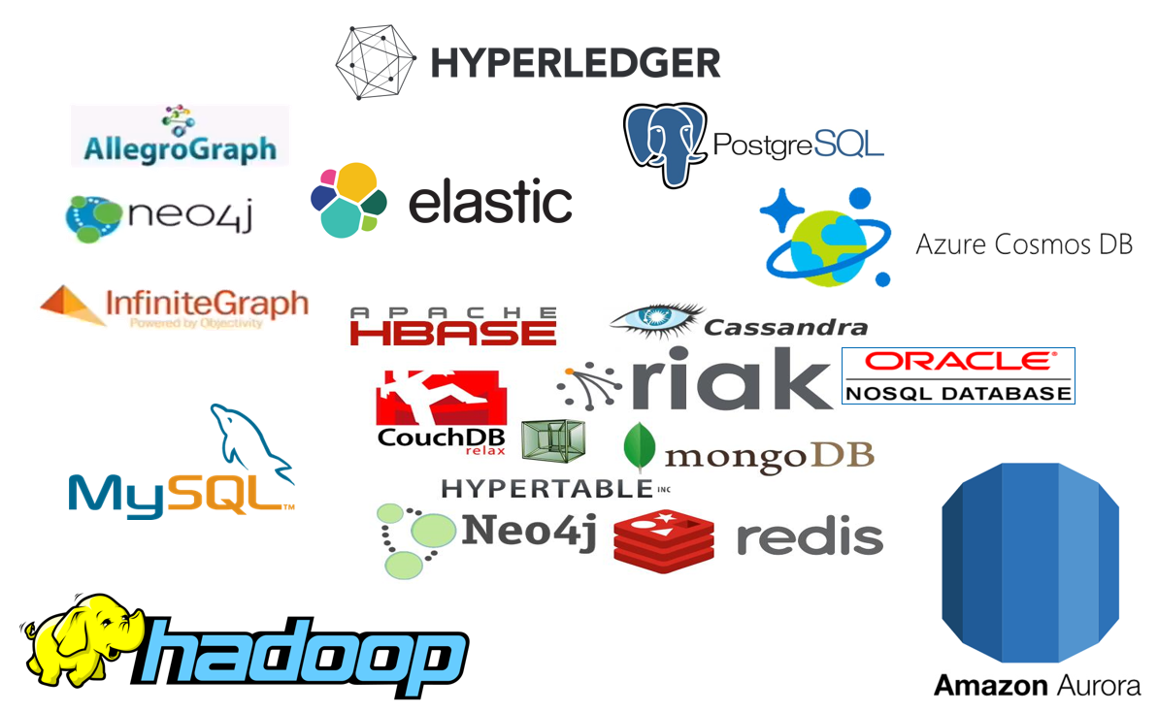



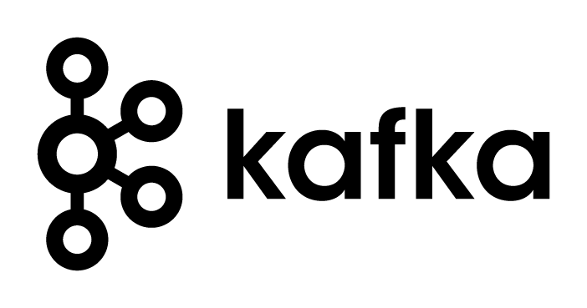



Introducing Apache Kafka – Part One The Event Fabric tying everything together
µ
µ
Three Part Online Meetup - 16 april 2020
Lucas Jellema, CTO & Architect AMIS | Conclusion

Slide 2
Overview
What is Apache Kafka? Core concepts and technology
Lab 1 – First hands-on with Apache Kafka
Programming
Brief introduction of Node (JS)
Lab 2 – Programmatic interaction with Apache Kafka
Shades of Data – Streaming, CQRS, Event Sourcing
The Eneco Case – The Event Streaming Platform
Lab 3 – DIY CQRS
Microservices and the quest for decoupling
Lab 4 – Microservices Interaction and Choreography
But wait – there is more:
Ecosystem and supporting tools
Alternative offerings (public cloud and stand-alone)
Part One
Part Two
Part Three

Slide 3


http://etc.ch/QmfH

Slide 4


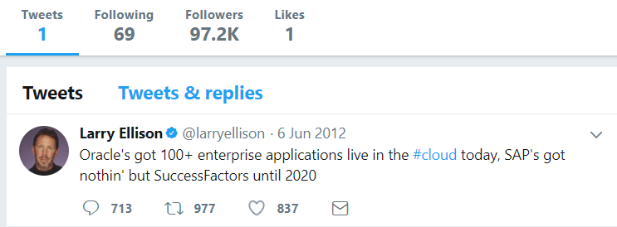
Heck, I do not even know these people and they may not know me [personally] – just my pearls of wisdom. And if they are late to the party, they can also check out the historic archives of my eloquence
Without fretting about the numbers of readers involved and whether they are in the same time zone as me and online when I publish my messages – and which device they use
It would be so nice if I could publish my ideas and actions, accessible near instantly for everyone who is interested
Online Meetup Introducing Apache Kafka - Part One of Three

Slide 5
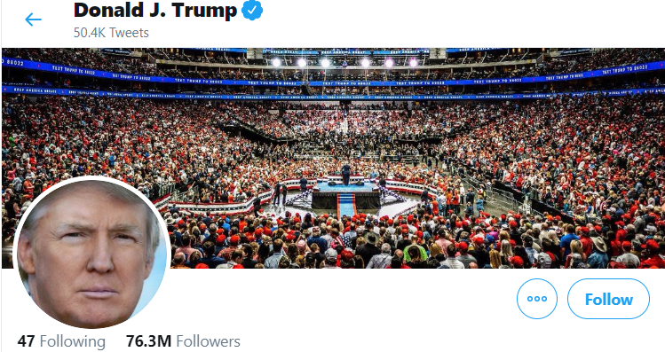
Heck, I do not even know these people and they may not know me [personally] – just my pearls of wisdom. And if they are late to the party, they can also check out the historic archives of my eloquence
Without fretting about the numbers of readers involved and whether they are in the same time zone as me and online when I publish my messages – and which device they use
It would be so nice if I could publish my ideas and actions, accessible near instantly for everyone who is interested
Online Meetup Introducing Apache Kafka - Part One of Three

Slide 6

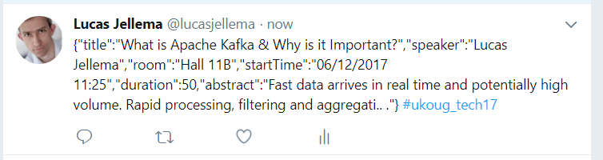
Decoupled communication
0, 1 or many followers
Scalable number of messages (and parties)
Reliable (mostly available, few messages lost)
Full history
Open: cross device, cross location
Not Sub-second, near real-time fast
Rate limited (#messages/minute)
Size limited (140-280 characters)
Format limited (text)
Not for private interactions
Not (really) for programmatic use
Online Meetup Introducing Apache Kafka - Part One of Three

Slide 7
What does the Twitter for System Driven Event Interaction look like?
Decoupled communication – organized per topic
0, 1 or many Consumers per Topic
Scalable number of messages (and parties)
Reliable (distributed)
Full history
Open: libraries in many technologie & REST APIs

Slide 8
What does the Twitter for System Driven Event Interaction look like?
Decoupled communication – organized per topic
0, 1 or many Consumers per Topic
Scalable number of messages (and parties)
Reliable (distributed)
Full history
Open: libraries in many technologie & REST APIs
Near real-time fast
No Rate Limit
No enforced size limit
Anything goes (it’s all byte[])
On premises or in cloud, private or trusted
Very much for programmatic use

Slide 9
Events
Consumers
Producers
Robust, Scalable, Fast, History Retention
Containerized/Cloud-enabled
Open

Slide 10
Messaging as we know it
JMS, Oracle Advanced Queuing, IBM MQ, MS MQ, RabbitMQ, MQTT, XMPP, WebSockets, Apache ActiveMQ, AMQP , …
Challenges
Costs
Scalability (size and speed)
(lack of) Distribution (and therefore availability)
Complexity of infrastructure
Message delivery guarantees
Lack of technology openness
Deal with temporarily offline consumers
Retain history

Slide 11

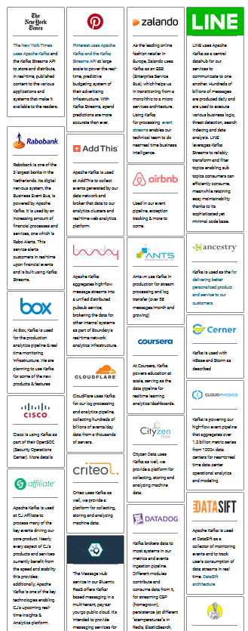

Introducing Apache Kafka
..- 2010 – creation at Linkedin
Message Bus | Event Broker
High volume, low latency, highly reliable, cross technology
Scalable, distributed, strict message ordering, ….
2011/2012 – open source under the Apache Incubator/ Top Project
Kafka is used by many large corporations:
Walmart, Cisco, Netflix, PayPal, LinkedIn, eBay, Spotify, Uber, Sift Science, Zalando, The New York Times, Airbnb, Coursera, ING Bank,…
And embraced by many software vendors & cloud providers
Client libraries available for Node, Java, C/C++, Python, Ruby, PHP, Go, Rust, .NET, Perl, Scala DSL, Clojure, Swift and more
Commercial backing by and Enterprise support from Confluent

Slide 12
Consumers
tcp
Producers
tcp

Slide 13
Consumers
Producers
Topic

Slide 14
Kafka terminology
Topic
Message
== ByteArray
Broker
Producer
Consumer
Message
Key
Value
Time
Producer
Consumer
Broker
Topic

Slide 15
Key
Value
Time
Consumers
Producers
Broker
Topic

Slide 16
Consuming
Messages are available to consumers only when they have been committed
Kafka does not push
Unlike JMS
Read does not destroy
Unlike JMS Topic
(some) History available
Offline consumers can catch up
Consumers can re-consume from the past
Delivery Guarantees
Ordering maintained
At-least-once (per consumer) by default; at-most-once and exactly-once can be implemented

Slide 17
Key
Value
Time
Consumers
Producers
Broker
Topic
Message Log

Slide 18


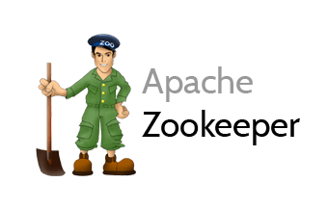
Cluster
Consumers
tcp
Producers
tcp
Broker
Topic
Partition
Consumer Group
Partition Log
Replica

Slide 19
What’s so special?
Durable transactions
Scalable
High volume
High speed
Available
Distributed
Open
Quick start
Free (no license costs)
“Self Fulfilling Prophecy” (positive feedback loop feeding from buzz around Kafka)
Eco system, tools/libraries/resources, cloud services

Slide 20



Alternatives for Apache Kafka’s Distributed Streaming Event Platform
Apache Pulsar
Solace PubSub+ Event Portal
Rabbit MQ
Apache Active MQ
Streaming Data libraries
Apache Spark Streaming, Conduit, Faust, Apache Flink, Apache Storm, Samza, Apache Beam, Apache Flume

Slide 21
Managed Kafka (-like) Cloud Offering
AWS
SQS
Managed Streaming for Apache Kafka (Amazon MSK)
EventBridge, Kinesis
Azure
Event Hub
EventGrid, Stream Analytics
Oracle Cloud Infrastructure
Streams
Google Cloud Platform
PubSub
DataFlow
… (Heroku Managed Kafka, Alibaba Cloud LogHub, IBM Event Streams,…)
?

Slide 22
Overview
What is Apache Kafka? Core concepts and technology
Lab 1 – First hands-on with Apache Kafka
Programming
Brief introduction of Node (JS)
Lab 2 – Programmatic interaction with Apache Kafka
Shades of Data – Streaming, CQRS, Event Sourcing
The Eneco Case – The Event Streaming Platform
Lab 3 – DIY CQRS
Microservices and the quest for decoupling
Lab 4 – Microservices Interaction and Choreography
But wait – there is more:
Ecosystem and supporting tools
Alternative offerings (public cloud and stand-alone)

Slide 23
http://etc.ch/QmfH

Slide 24
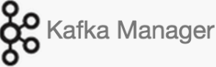

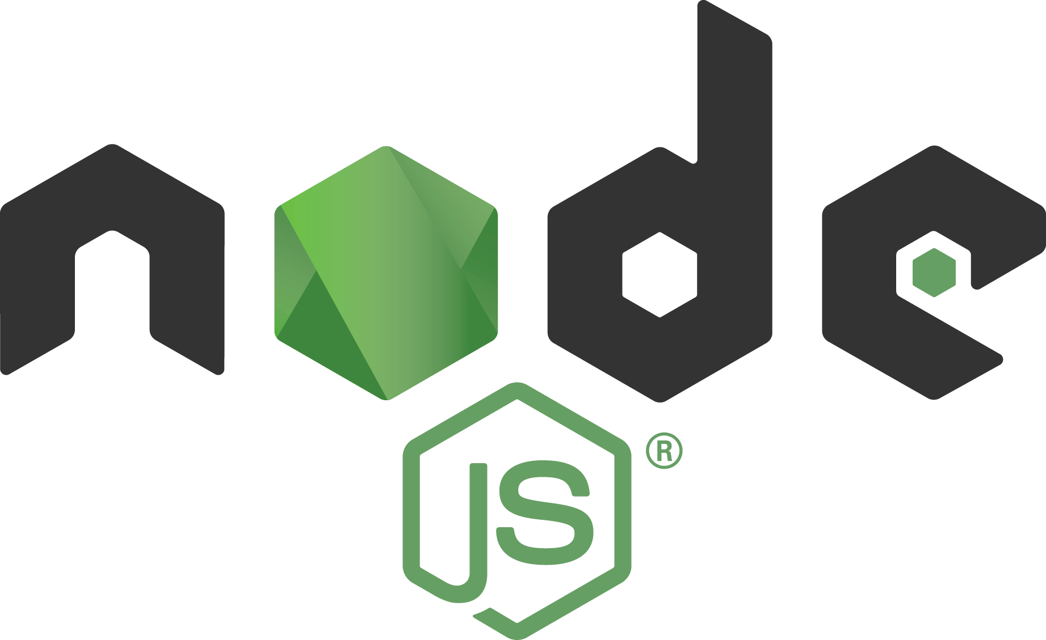

Lab Environment
2181
9092
9093
9094
Docker Compose
kafka
28044
28042
Browser
Laptop
localhost

Slide 25

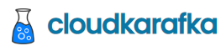
Partly Clouded Lab Environment
2181
CloudKarafka Console
Browser
Laptop
localhost

Slide 26
Quick Demo – Apache Kafka through Kafka Console
Show interaction at the most basic level
Broker
Topic
partition
Produce Message
Consume Message
Consumer Group

Slide 27
Lab 1: First steps with Apache Kafka
Using Kafka Console
Create a topic
Publish messages to topic
Using Kafka Console
Consume messages from topic
Work with Apache Kafka HQ GUI to
inspect the Kafka Cluster
produce additional messages
consume message from a special Consumer Group
9092
Docker Compose
kafka
28042
Browser
Laptop
localhost

Slide 28
Overview
What is Apache Kafka? Core concepts and technology
Lab 1 – First hands-on with Apache Kafka
Programming against Apache Kafka
Brief introduction of Node (JS)
Lab 2 – Programmatic interaction with Apache Kafka
Shades of Data – Streaming, CQRS, Event Sourcing
The Eneco Case – The Event Streaming Platform
Lab 3 – DIY CQRS
Microservices and the quest for decoupling
Lab 4 – Microservices Interaction and Choreography
But wait – there is more:
Ecosystem and supporting tools
Alternative offerings (public cloud and stand-alone)

Slide 29
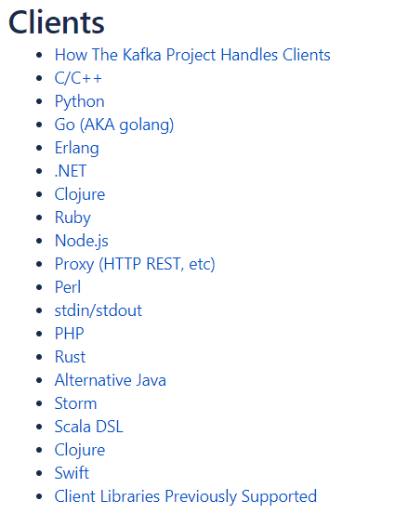


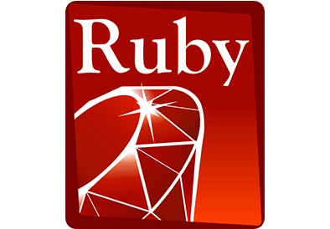
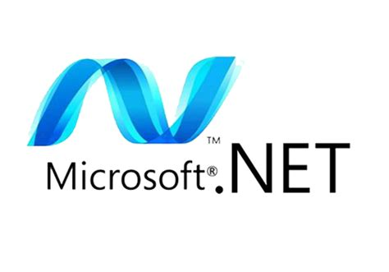

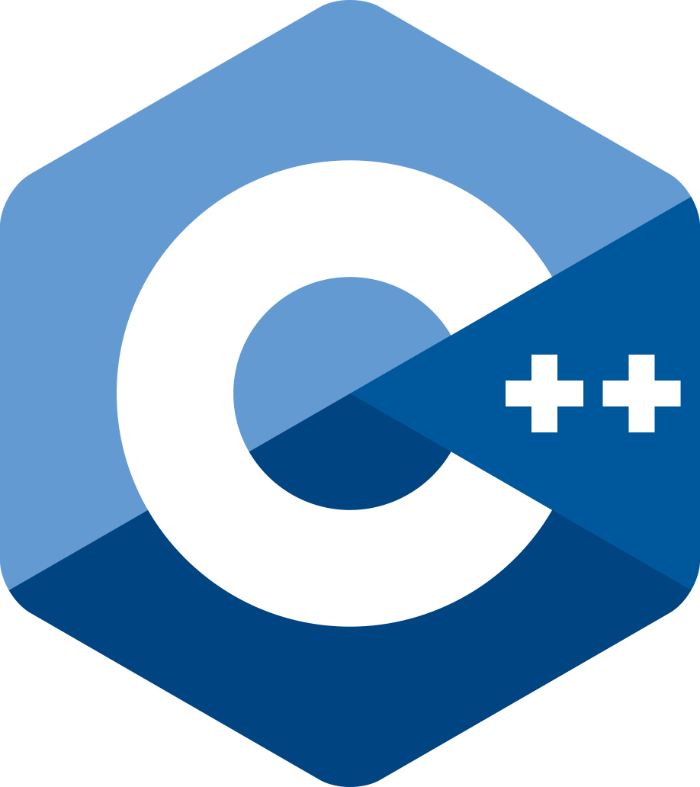





Programming against Kafka: Client Libraries
Client libraries
C/C++
Python
Go
Java
.NET
JavaScript/Node
Ruby
Scala
and more..
Also: REST Proxy (part of open source Confluent Platform)
Produce, Consumer and manage through REST API calls
Notes:
https://cwiki.apache.org/confluence/display/KAFKA/Clients

Slide 30
Programming against Kafka: Typical Steps in a Client Producer Application
Create a connection
connected to one or more brokers in a cluster or to the Zookeeper node
you need the broker-endpoints or the Zookeeper endpoint
optionally use credentials or certificate for authentication
Create a Producer on top of the connection
When the Producer-Connection is available…
[Optionally] Start a Transaction
Produce message[s] to topic(s) [or specific topic partition(s)]
[Optionally] Commit the Transaction
[Repeat Message Production]
Disconnect the producer/close the connection
2181
9092
9093
9094
Client
Application
Notes:
https://cwiki.apache.org/confluence/display/KAFKA/Clients

Slide 31
Programming against Kafka: Typical Steps in a Client Consumer Application
Create a connection
connected to one or more brokers in a cluster or to Zookeeper node
you need the broker-endpoints or the Zookeeper endpoint
optionally use credentials or certificate for authentication
Create a Consumer or a ConsumerStream on top of the connection
Subscribing to one or more topics
[Optionally] Associating with a Consumer Group
(Which leads to a link to one or topic more partitions on the Kafka brokers)
[Optionally] Overriding the auto-commit
When the Consumer or Stream is available…
Consume message[s] (from the specified subscriptions)
[Optionally, depending on auto-commit poperty] Commit the Transaction
[Repeat Message Consumption]
Disconnect the consumer/close the connection
2181
9092
9093
9094
Client
Application
Notes:
https://cwiki.apache.org/confluence/display/KAFKA/Clients

Slide 32


Introducing Node
JavaScript dates back to mid 1990s and the Netscape Navigator browser
NodeJS was born in 2009:
Server Side JavaScript
Based on V8 Javascript Engine
Using npm as package and build manager
Simple, light weight, faster developer feedback, leveraging 15 years of web development
2010: Express – framework for REST APIs
2010-2020: many Node libraries, drivers, modules appear
Core component in MEAN-stack (MongoDB, Express, Angular, NodeJS)
Node (JavaScript) is one of the primary runtime engines for Serverless Functions
On all major cloud providers (AWS, Azure, GCP, Oracle Cloud Infrastructure)

Slide 33
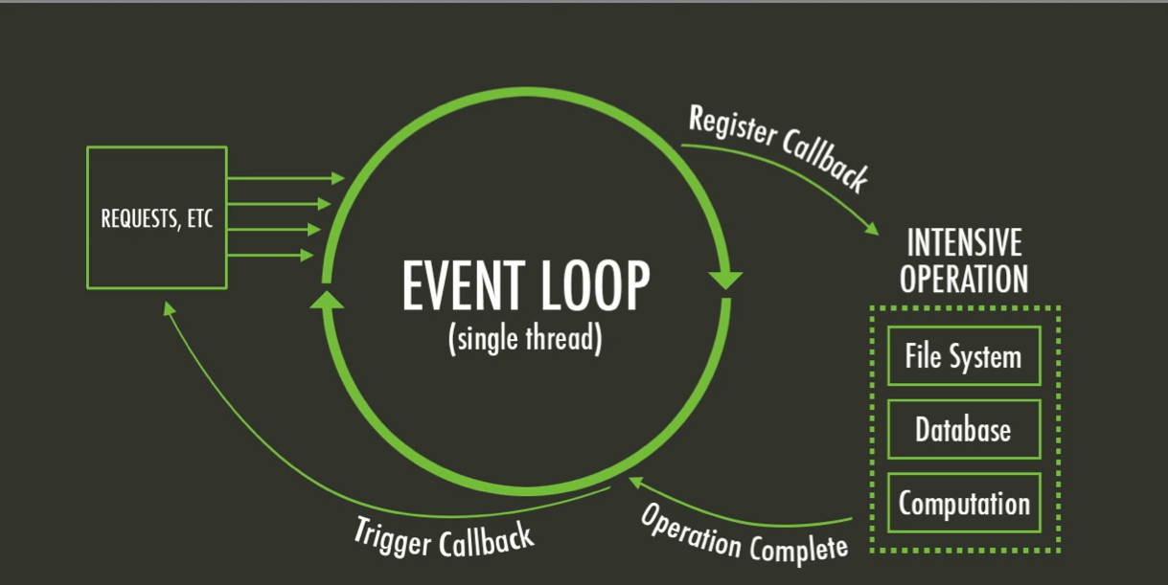
Introducing Node – Single Thread model
Multi-thread languages – such as Java – typically block when file system or network operations take place
Parallel processing continues in parallel threads
Threads consume resources and are only somewhat scalable
JavaScript has a main (single thread) event loop and uses asynchronous processing
Non-blocking handling of file system interactions, HTTP calls, network operations and other blocking actions
Scalable, very quick startup

Slide 34
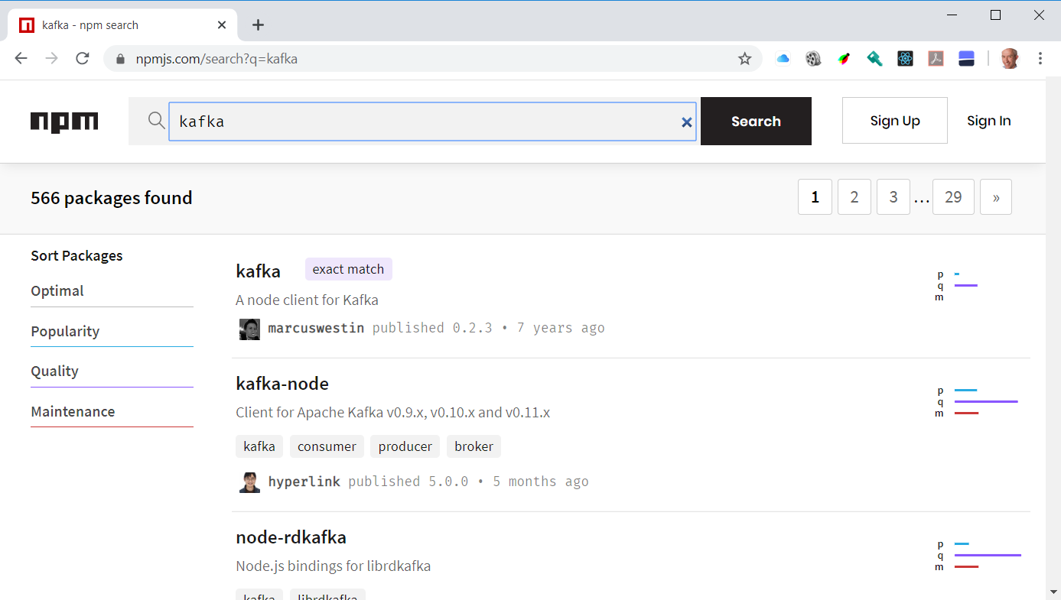
Introducing Node
NPM = Node Package Manager
To include libraries from the ecosystem
Leverages npm registry (> 1.2M NPM Modules available in April 2020)
Acquired by Microsoft – March 2020
To build and run Node applications
similar to Maven & Gradle (Java) or pip (Python)
Yarn and Turbo are popular alternatives
Notes:
http://www.modulecounts.com/

Slide 35
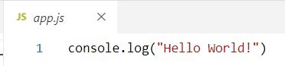
Hello World in Node
index.js
with the code to execute
(optional) package.json
with NPM dependencies, build and run configuration (compare Maven pom.xml)
Create Node application:
npm init (optional, you can just create a text file by hand)
Run Node application
node index.js
npm start
Add dependencies
npm install <name of module> --save

Slide 36
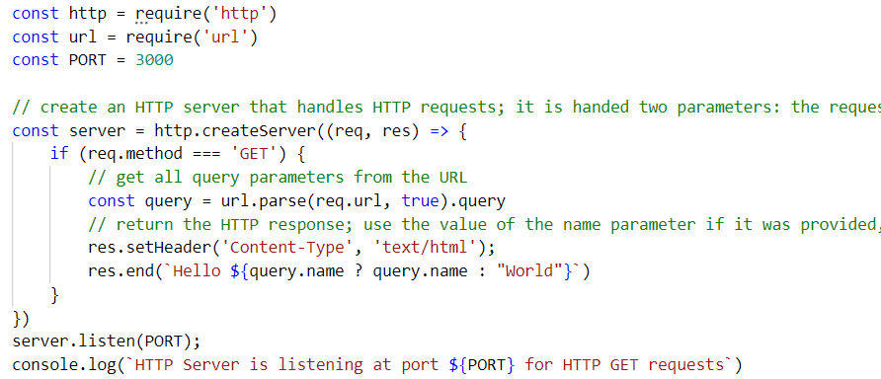
Hello World Web Application
Node is very good at handling HTTP Requests
And at making them
It is a great technology to implement REST APIs and backends for Web and Mobile applications

Slide 37
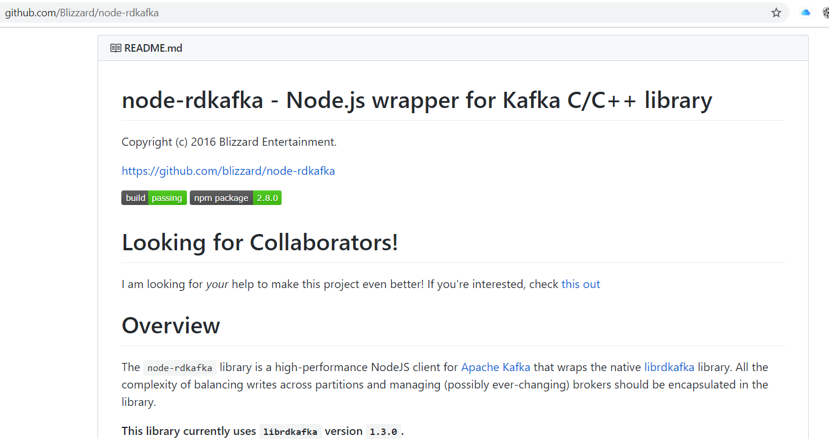
Node and Kafka
We will use NPM module node-rdkafka to facilitate the interaction with Apache Kafka from our Node application
This module leverages a C/C++ library for Kafka interactions

Slide 38
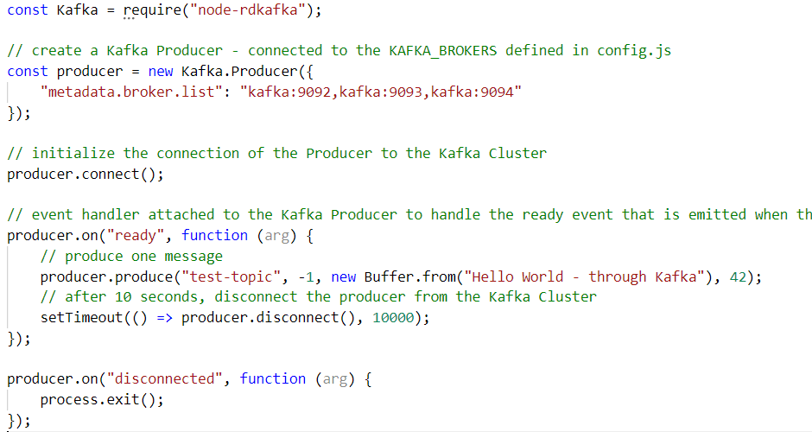
Node and Kafka – a simple producer

Slide 39
Node and Kafka – a simple producer

Slide 40
Node and Kafka – a simple producer

Slide 41
Node and Kafka – a simple producer

Slide 42
Node and Kafka – a simple producer

Slide 43
Node and Kafka – a simple producer

Slide 44
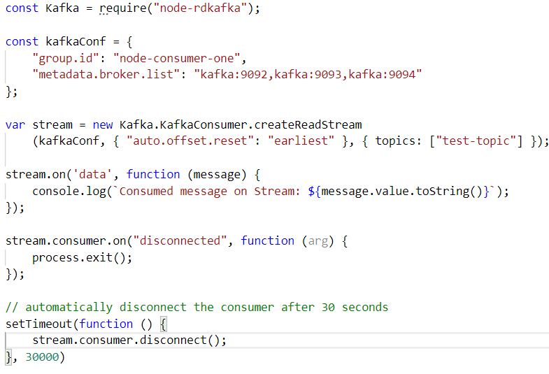
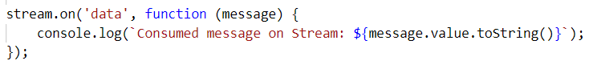
Node and Kafka – a simple consumer

Slide 45
http://etc.ch/QmfH

Slide 46
Overview
What is Apache Kafka? Core concepts and technology
Lab 1 – First hands-on with Apache Kafka
Programming against Apache Kafka
Brief introduction of Node (JS)
Lab 2 – Programmatic interaction with Apache Kafka
Shades of Data – Streaming, CQRS, Event Sourcing
The Eneco Case – The Event Streaming Platform
Lab 3 – DIY CQRS
Microservices and the quest for decoupling
Lab 4 – Microservices Choreography
But wait – there is more:
Ecosystem and supporting tools
Alternative offerings (public cloud and stand-alone)

Slide 47
Lab 2 – Programmatic interaction with Apache Kafka
Prequisite: local Node runtime
Step One:
Hello World in Node
Step Two:
Node application to Produce Messages to Kafka Topic
Node application to Consume Messages from Kafka Topic
Bonus Step Three:
Node Web Application to Produce Messages from HTTP Request
Node Web Application to return Messages on Topic in HTTP Response

Slide 48
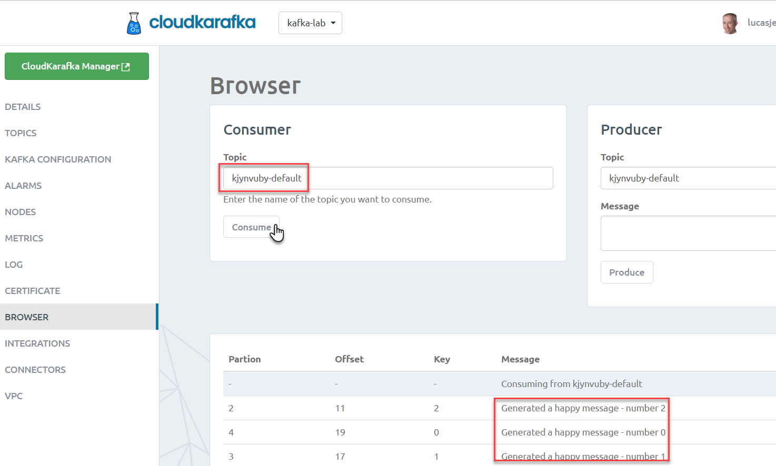
kjynvuby-default
Consume
Produce

Slide 49
Next Two Sessions – Monday and Wednesday Next Week
What is Apache Kafka? Core concepts and technology
Lab 1 – First hands-on with Apache Kafka
Programming against Apache Kafka
Brief introduction of Node (JS)
Lab 2 – Programmatic interaction with Apache Kafka
The Eneco Case – The Event Streaming Platform
Shades of Data – Streaming, CQRS, Event Sourcing
Lab 3 – DIY CQRS
Microservices and the quest for decoupling
Lab 4 – Microservices Choreography
But wait – there is more:
Ecosystem and supporting tools
Alternative offerings (public cloud and stand-alone)
Monday 20-04
Wednesday 22-04

Slide 50


Thank you for your attention I hope this was useful
lucas.jellema@amis.nl | technology.amis.nl | @lucasjellema | lucas-jellema

